Slide 1
Factors influencing children’s general knowledge assessment
Yang Shi, Guanqian Wang, Weixin Zhong, Fenfen Tang-4/20/18

Slide 2

Research Question
What are the key factors that is influencing/helpful to predict kindergarten children’s general knowledge achievement?
Notes:
Yang

Slide 3
Preview
Introduction
Assumption checking
Variable selection and model building
Dignostics and evaluation
Remidies
Conclusions

Slide 4
Sample & Data Source
Data is from National Center for Education Statistics (NCES, publicly available)
n = 11,912 kindergarten children from public and private schools across the United States of America with diverse background of gender, race, family social-economic and health status, etc,.
Notes:
Yang

Slide 5
Candidate variables
Variables | Label | Type
General Knowledge Score | T-score (Standardized, 0-100) | Continuous
Age | 54 - 79 (months) -- 4.5 - 6.6-year old
TV watched at weekdays | 0 - 20 hours
TV watched at weekends | 0 - 44 hours
Race | White, African American, Asian, Latino, Others | Nominial
Gender | Female, Male
School | Public, Private
Kindergarden Class | Morning, Afternoon, All-day
Social Economic Status | Low to High (1-5) | Ordinal
Motor Skills | Low to High (1-17)
Notes:
10 candidate variables

Slide 6
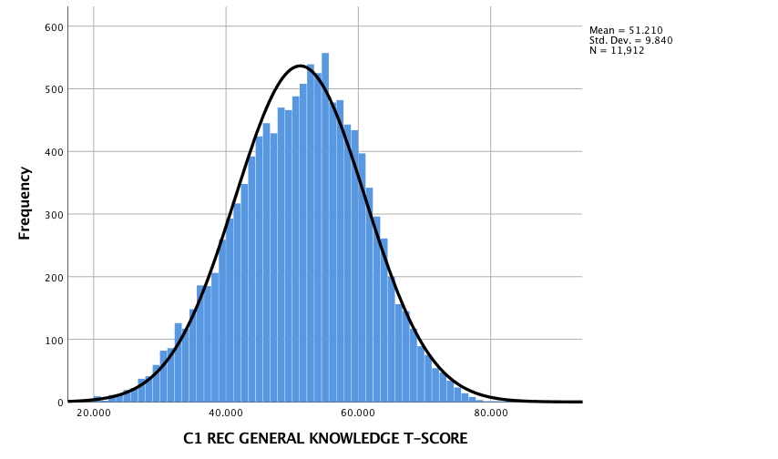
Normality of Dependent Variable
Notes:
Normality assumption of dependent variable was met. General Knowledge Score ranges from 20.3 to 83.6, with Mean to 51.2 (SD = 9.8).

Slide 7
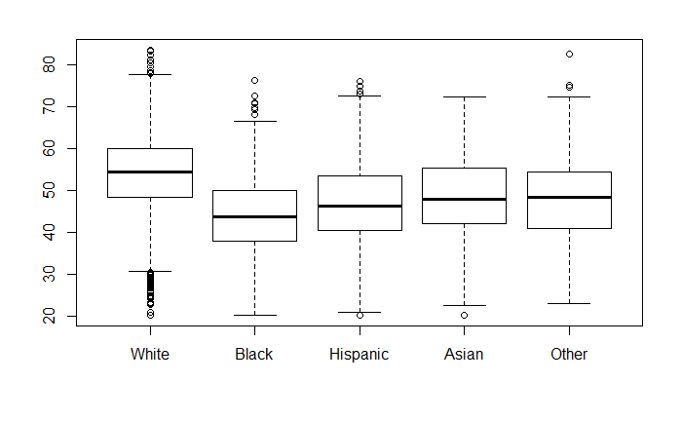
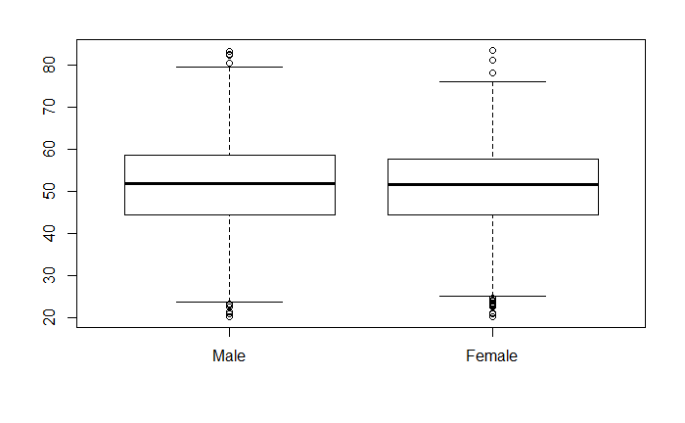
General analysis
Boxplot of race against Y
Boxplot of gender against Y
Notes:
As anticipated, White students have highest mean and central 50% percentile range (25%-75%), followed by Asian students, and the mean and 50% percentile range
African-American students are the lowest among all race groups.
The plot shows that male has slightly higher mean and central 50% percentile range (25%-75%), the effect of gender needs to be further determined.

Slide 8
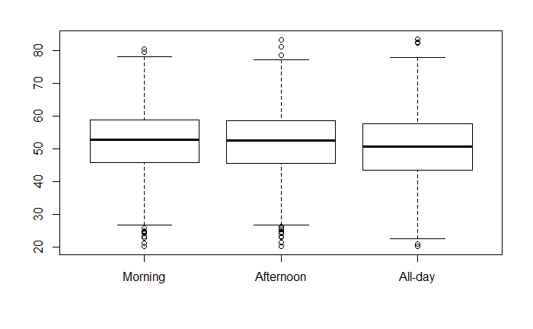
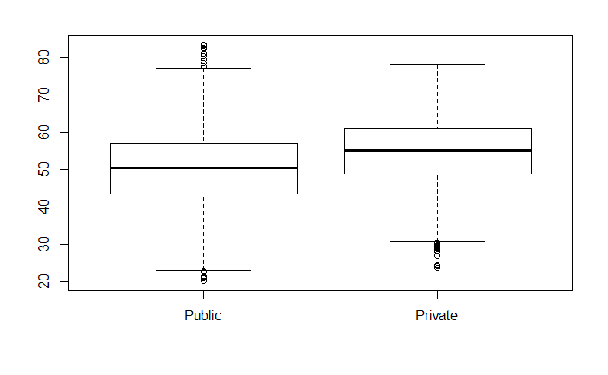
General analysis
Boxplot of kindergarten against Y
(in terms of morning, afternoon, or all day)
Boxplot of kindergartden against Y
(in terms of private or public)
Notes:
the morning and afternoon kindergarten has the similar mean and central 50% percentile range, with all-day being the lowest.
Compared to public school students, private schools students have higher average score and smaller standard deviation.
Seems like the influence of private or public is more significant.

Slide 9
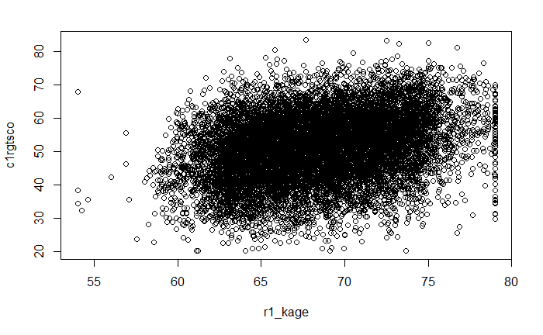
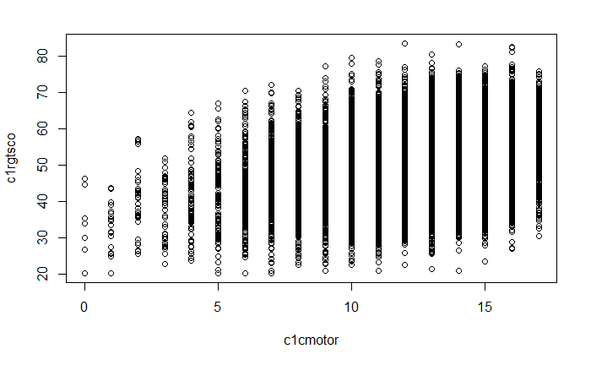
General analysis
Plot of child’s age against Y
Plot of child’s assessment on composite motor skills against Y
Notes:
it looks like there’s a correlation between age and Y.
As it’s shown on the plot, there’s regression of Y on motor skills. Y is increased while child’s assessment on composite motor skills is higher, we’d like to include the variable in our model for further validation.

Slide 10
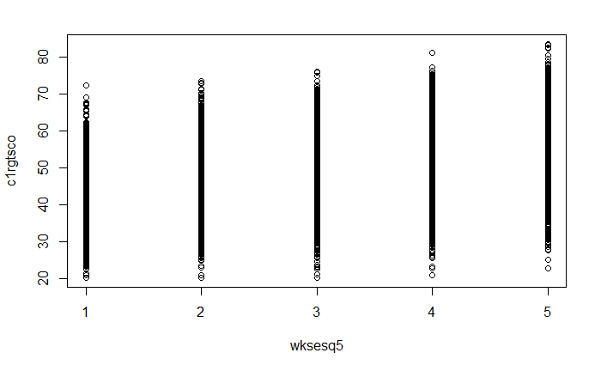
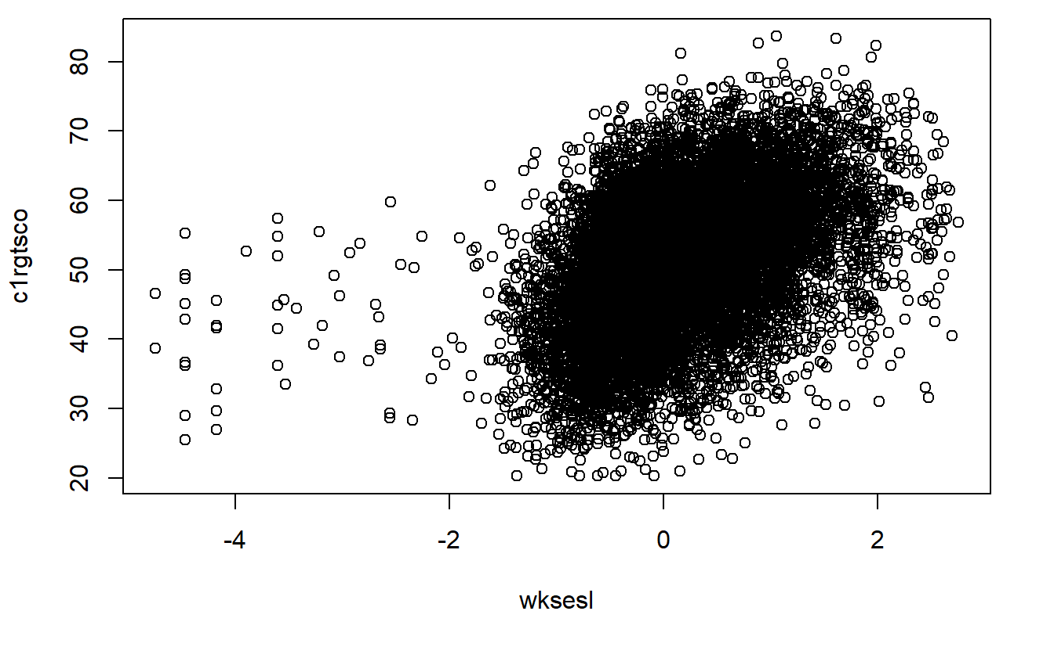
General analysis
Plot of SES scale of the family against Y (categorical)
Plot of SES scale of the family against Y (continuous)
(SES) : Social Economic Status
Notes:
the SES is scaled in two ways. We observed difference level of influence. From the categorical one, we can observe weak correlation, however we can see the continuous SES looks more significant. We will have further discussion on which we want to include on our model.

Slide 11
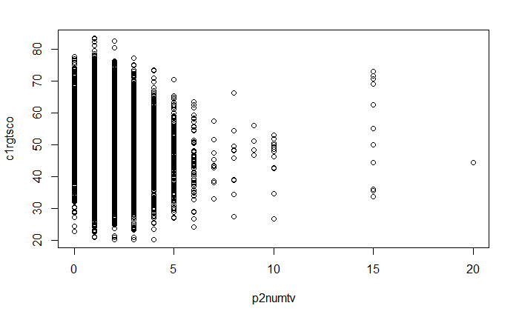
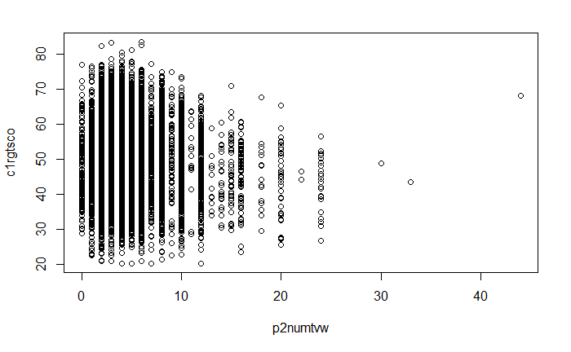
General analysis
Plot of number of hours TV watched on the weekdays against Y
Plot of number of hours TV watched on the weekends against Y
Notes:
We observed weak relationship between TV and Y, but we decide to perform further test….
the trends are same regardless it’s weekdays or weekends.

Slide 12
Model building and variable selection
AIC, BIC Forward/Backward
Interprete the Model
Adjust Significance Level
Notes:
Weixin
We build our model using AIC selection

Slide 13
Model building and variable selection
Our Model: (Same Result for both AIC and BIC; and for all Both Direction)
General Knowledge Score ~ Social Economic Status + Race + Motor Skill + Age + Class Type + School Type + Gender

Slide 14
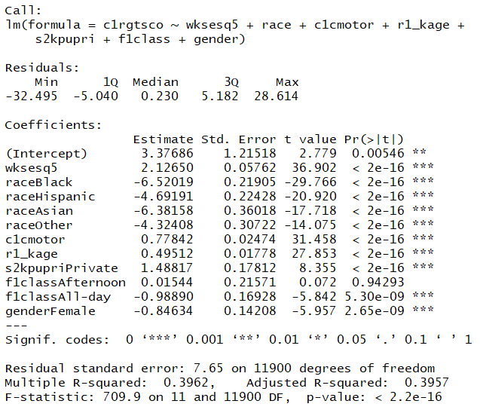
Model building and variable selection
All variables are significant at 0.001 level (after adjusting significance level for multiple testing)
Race
SES
Motor skill score and age are positively related to RGT-score
On average, children in private schools have higher RGT-score than those in public schools
Time of Class
Gender
R^2 is less than 0.4

Slide 15
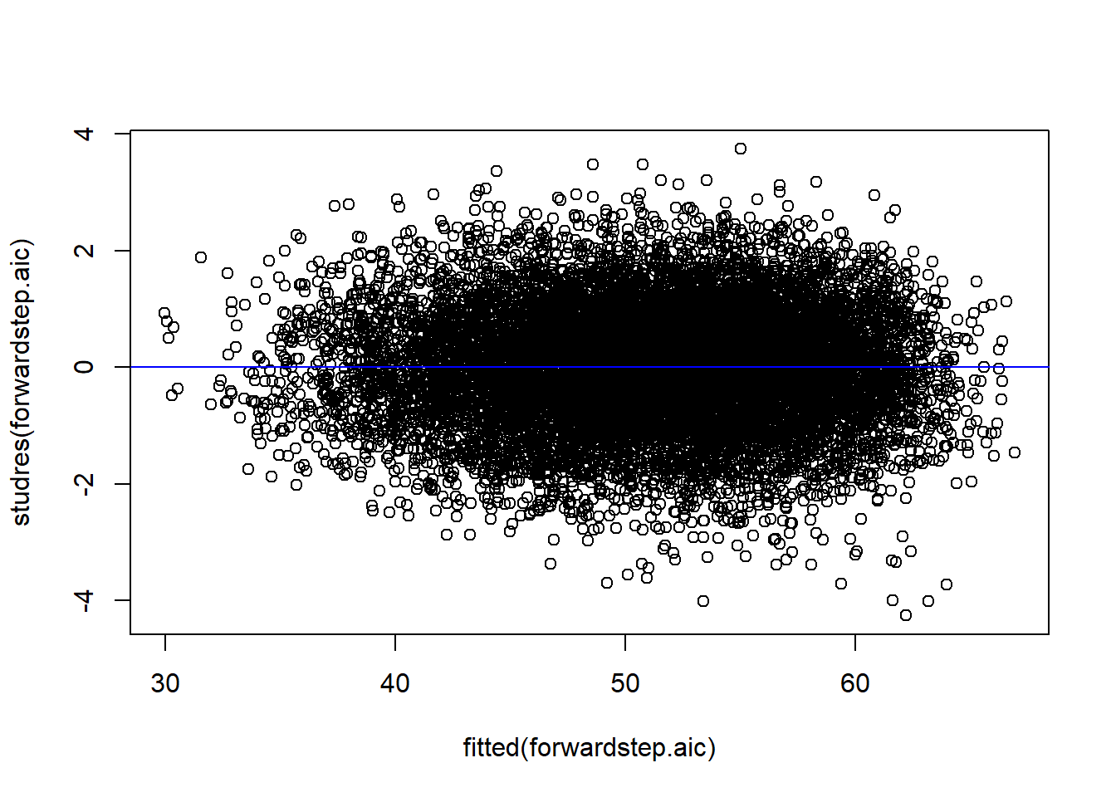
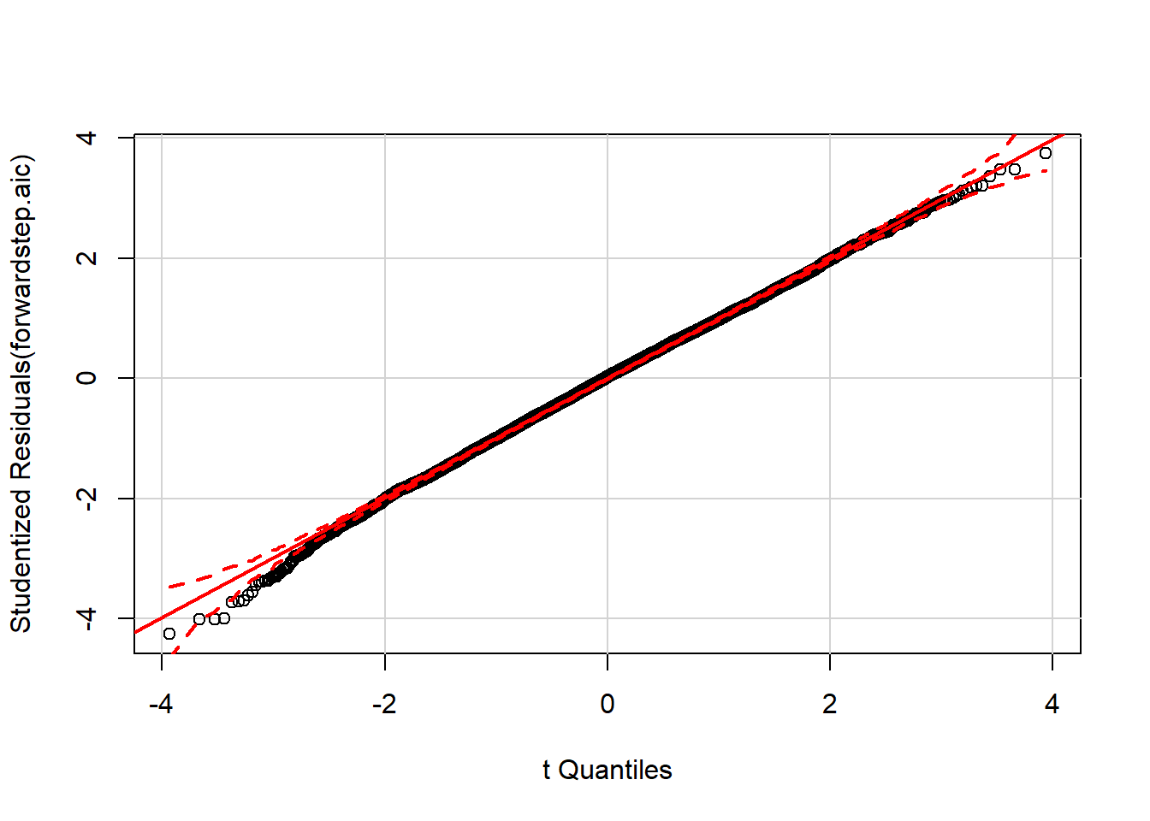
Diagnostics
Constant Variance
Normality
Independence (Assumed)
Notes:
Guanqian

Slide 16
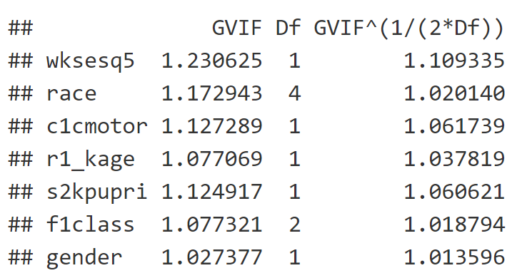
Diagnostics
Multicollinearity Problem
VIF

Slide 17
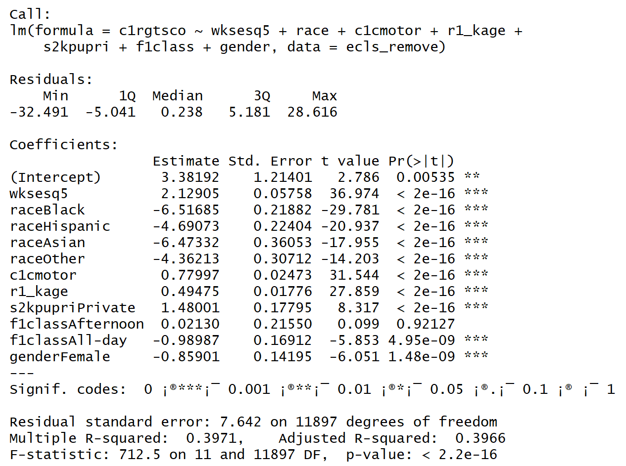
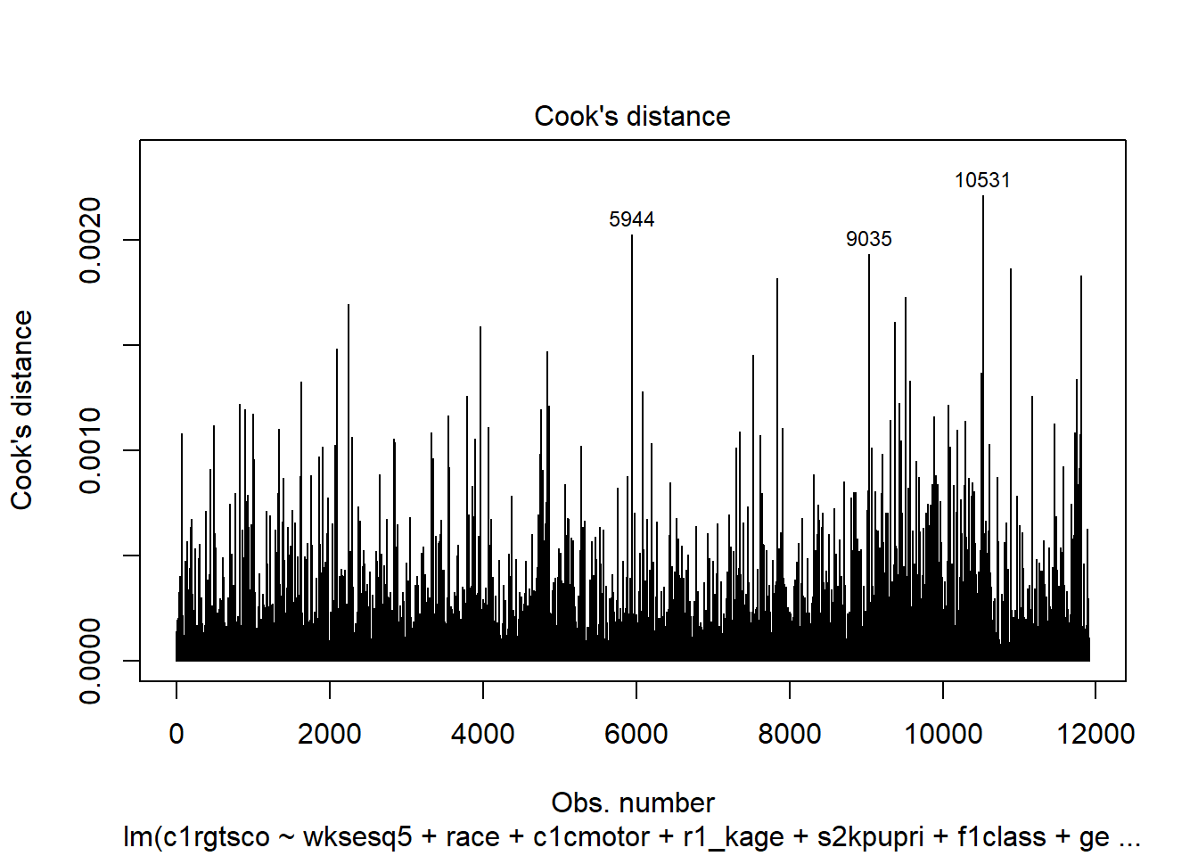
Diagnostic
Outliers and Influential Points
Find 3 Influential Points
Model After Remove Influential Points is The Same

Slide 18
Cross Validation
Double CV
PRESS
K-fold
Notes:
Weixin

Slide 19
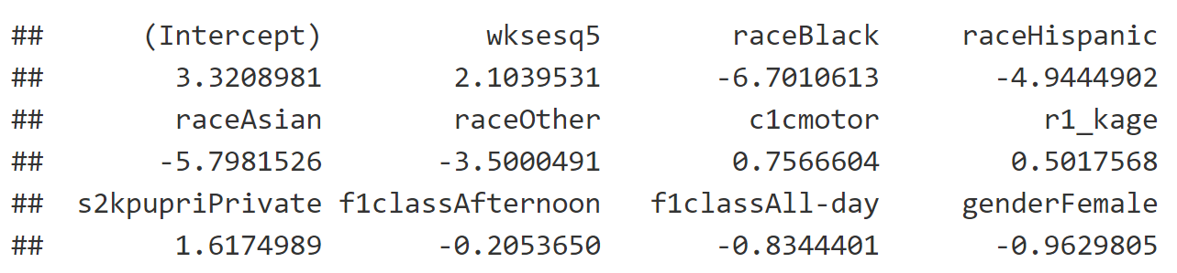
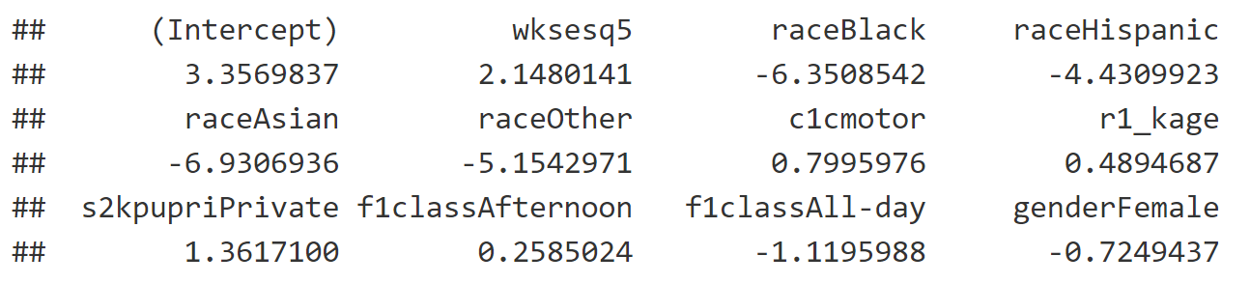
Cross Validation - Double Cross Validation
MSPR value for two sample are very close (58.01853 and59.49036 )
Coefficient Comparison: (Also Fairly Close)

Slide 20
Cross Validation - PRESS
PRESS = 697814.1
SSE = 696355
PRESS is Only Slightly Larger Than SSE

Slide 21
Cross Validation - 10-fold
MSE = 58.51721
Average MSPR = 58.59942
They are Fairly Close
Conclusion From CV:
Our Model Has Good Predictability
Above Statements are Subjective Comment

Slide 22
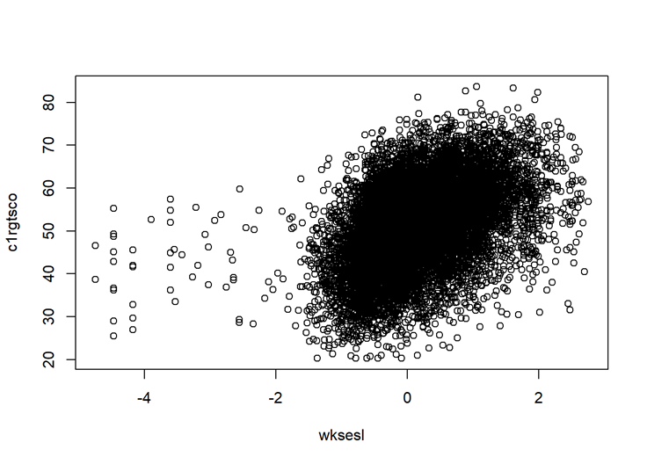
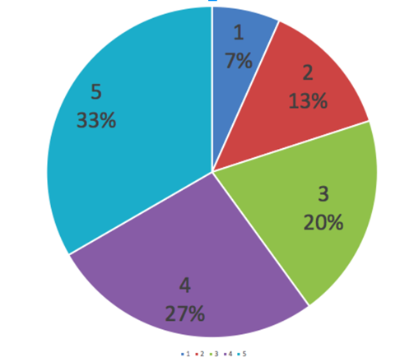
Remedial Actions
Try Other Variables: Continuous SES
Notes:
Guanqian

Slide 23
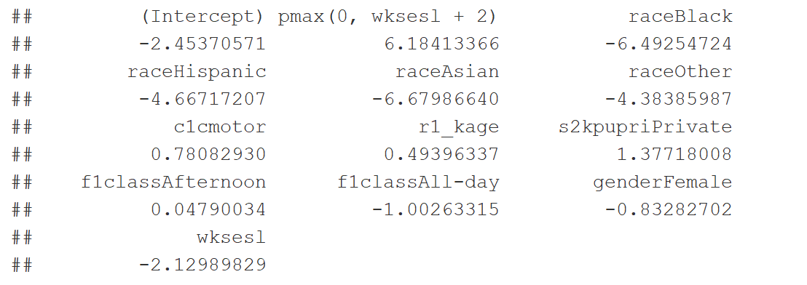
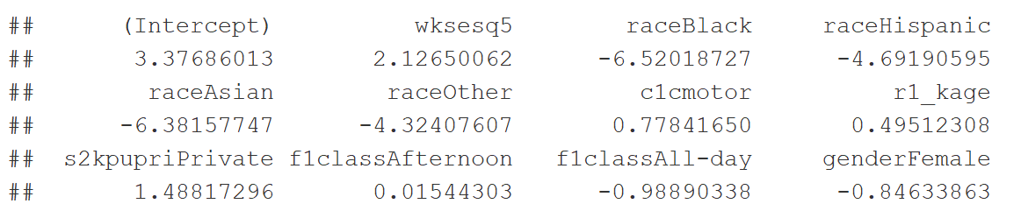
Continuous SES
Compare Coefficients
Except Terms About SES, Others are Very Similar
Continuous SES:
Categorical SES:

Slide 24
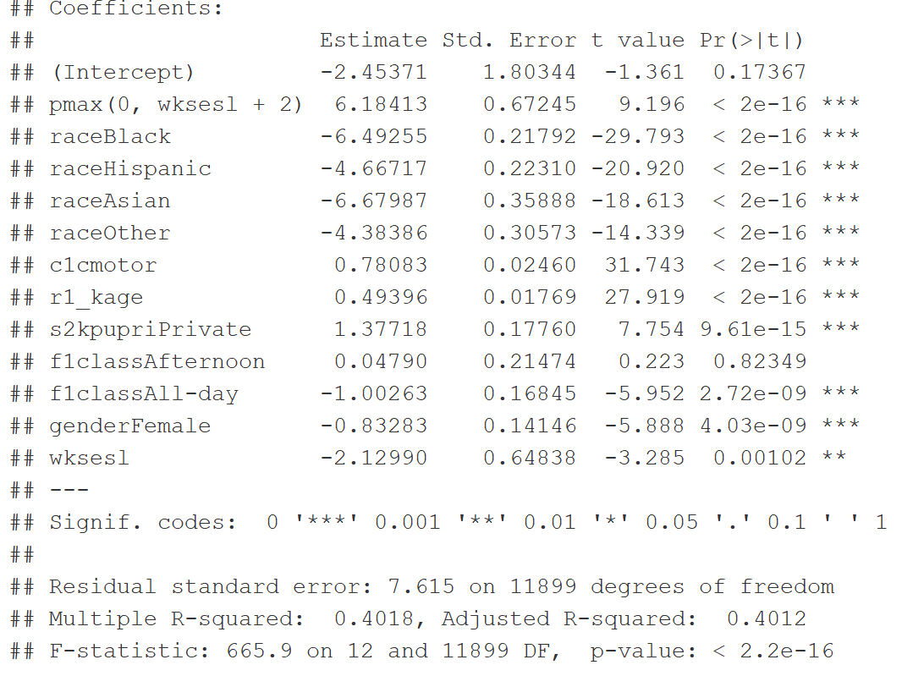
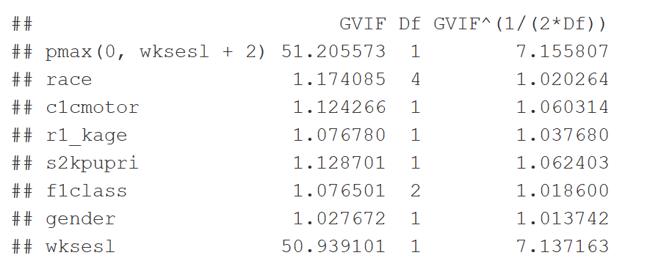
Continuous SES
VIF and Summary
Should We Make SES Piecewise?

Slide 25
Conclusion
Important Findings
Race, Gender, SES, Time of Class, Age, School, Motor Skill are Important Factors Influencing Test Score
The Data Set May Should Include More Factor/Factors
SES May Deserve Some Further Study
Future Research
More Factor/Factors’ Data Should be Collected
The Unevenly Distributed Data Points of Variables Could Cause Problems
Interaction Term Investigation
More Different and Advanced Analysis
Notes:
Guanqian

